Slide 1

Aviation Safety 2010
The Year In Review
Jim Burin
Director of Technical Programs
Notes:
This morning we will look at aviation safety data for this year and compare it to past years
I would like to acknowledge the assistance of Paul Hayes of Ascend in compiling the data to be presented here this morning

Slide 2
The Fleet - 2010
Type Western Built Eastern Built Total
Turbojets 20,239 1,390 21,629
Turboprops 4,766 1,351 6,117
Business Jets 16,638
Source: Ascend
Notes:
As a starting point, this is what the commercial and corporate aircraft fleets look like in 2010
As you can see, approximately 6% of the turbojet fleet is Eastern built while 20% of the turboprop fleet is Eastern built
The Commercial turbojet numbers grew about 2% from 2009
The commercial turboprop numbers grew for the first time in several years---almost 2%
And the business jet numbers grew approximately 4%
These numbers reflect the total fleets. The active fleets, the aircraft actually in service, are somewhat smaller:
About 9% of the turbojet fleet is inactive – and growing
While about 14% of the turboprop fleet is inactive
4% of the business jet fleet was inactive
Before we look at this year’s record, let’s look back one year….

Slide 3
Major Accidents
Commercial Jets
1 January 2009 to 31 Dec 2009
CFIT
LOC
Excursion
Date | Operator | Aircraft | Location | Phase | Fatal
15 January | USAirways | A-320 | New York, USA | Climb | 0
25 February | THY | B-737 | Amsterdam, Netherlands | Approach | 9
9 March | Aerolift | IL-76 | Entebbe, Uganda | Climb | 11
9 March | Lion Air | B-737 | Jakarta, Indonesia | Landing | 0
23 March | FedEx | MD-11 | Tokoyo, Japan | Landing | 2
9 April | Avistar Mandiri | BAE-146 | Wamena, Indonesia | Approach | 6
29 April | BAKO Air | B-737 | Massamba, DRC | Enroute | 7
31 May | Air France | A-330 | Atlantic Ocean | Enroute | 228
6 June | Myanma Airways | F-28 | Sittwe, Myanmar | Landing | 0
30 June | Yeminia Airways | A-310 | Comoros | Approach | 152
15 July | Caspian Airlines | TU-154 | Qazvin, Iran | Climb | 168
24 July | Aria Air | IL-62 | Mashhad, Iran | Landing | 16
21 October | Azza Transport | B-707 | Sharjah, UAE | Takeoff | 6
12 November | Rwandair Express | CRJ-100 | Kijali, Rwanda | Taxi | 1
19 November | CAA | MD-82 | Goma, DRC | Landing | 0
28 November | Avient Aviation | MD-11 | Shanghai, China | Takeoff | 3
22 December | American Airlines | B-737 | Kingston, Jamica | Landing | 0
Source: Ascend
Notes:
This chart lists the major accidents that occurred in 2009 to commercial jet airplanes. This includes all scheduled and unscheduled passenger and cargo operations for Western and Eastern built commercial jet aircraft.
As you can see, there were 17 Major accidents.
9 of these major accidents were approach and landing accidents
There was one CFIT accident
There were 3 confirmed LOC accidents, and two that still are possible, but undetermined.
Let me point out that 6 of the 17 major accidents were runway excursions. Not listed are many runway excursions that involved substantial or minor damage – these are only the major damage accidents

Slide 4
Major Accidents
Commercial Jets
1 January 2010 to 1 November 2010
Date | Operator | Aircraft | Location | Phase | Fatal
January | CAA | B-727 | Kinshasa, DRC | Landing | 0
24 January | Taban Air | TU-154 | Mashhad, Iran | Landing | 0
25 January | Ethiopian Airlines | B-737 | Beirut, Lebanon | Climb | 90
22 March | Avistar-TU | TU-204 | Moscow, Russia | Approach | 0
13 April | Merpati Airlines | B-737 | Rendani, Indonesia | Landing | 0
13 April | Aerounion | A-300 | Monterrey, Mexico | Approach | 5
5 May | Satena | EMB-145 | Mitu, Colombia | Landing | 0
12 May | Afriqiyah Airways | A-330 | Tripoli, Libya | Approach | 103
22 May | Air India Express | B-737 | Mangalore, India | Landing | 158
27 July | Lufthansa | MD-11F | Riyad, Saudi Arabia | Landing | 0
28 July | Airblue | A-321 | Islamabad, Pakistan | Approach | 152
28 July | Mauritania Airways | B-737 | Conakry, Guinea | Landing | 0
16 August | Aires | B-737 | San Andres, Colombia | Landing | 2
24 August | Henan Airlines | EMB-190 | Yichan, China | Approach | 42
25 August | Passaredo Linhas Airways | EMB-145 | Vitoria Conquista, Brazil | Approach | 0
3 September | UPS | B-747 | Dubai, UAE | Approach | 2
24 September | Windjet | A-319 | Palermo, Italy | Landing | 0
Source: Ascend
Notes:
This chart lists the major accidents that have occurred up to 1 November of this year to commercial jet airplanes. This includes all scheduled and unscheduled passenger and cargo operations for Western and Eastern built commercial jet aircraft.
As you can see, there have been 17 major accidents so far this year
14 of these major accidents have been approach and landing accidents
There have been 2 CFIT accidents
There have been 2 LOC accidents
There have been 5 runway excursion major accidents. There have actually been 7 accidents where the aircraft has departed the runway – however, by definition, for an excursion, the aircraft wheels need to leave the runway surface. In two of the accidents, the aircraft did not have wheels when it arrived at the runway, and thus they were not runway excursion accidents.

Slide 5
Major Accidents
Worldwide Commercial Jets
2000 – 2010 (to 1 Nov)
40
1.20
Hull Losses
Western Major Accident Rate *
1.00
Major Accident Rate*
30
Major Accidents
0.80
20
19
19
17
17
0.60
17
16
17
13
13
13
11
0.40
10
0.20
2000
01
02
03
04
05
06
07
08
09
2010
* Reliable worldwide departure/rate data not available for Eastern-Built Aircraft
Notes:
This chart shows both the number of Major accidents and the major accident rate for commercial jet aircraft in losses per one million departures for the last 10 full years, plus this year to 1 November
The major accident numbers are for both Eastern and Western built aircraft
The rate is only for Western built aircraft because, even though we have the number of major accidents for Eastern built aircraft
we do not have reliable worldwide exposure data to calculate rates for them

Slide 6
Major Accidents
Business Jets
1 January 2010 to 1 November 2010
Date | Operator | Aircraft | Location | Phase | Fatal
5 January | Royal Air Freight | Lear 35 | Chicago, IL, USA | Approach | 2
14 February | Time Air | Citation Bravo | Schona, Germany | Enroute | 2
15 July | Prince Aviation | Citation Bravo | Bol, Croatia | Landing | 0
12 August | Ocean Air Taxi | Lear 55 | Rio de Janeiro, Brazil | Landing | 0
31 August | Trans Air | Citation II | Misima, PNG | Landing | 4
6 October | Aviones Taxi | Citation ISP | Veracruz, Mexico | Enroute | 8
Source: Ascend
Notes:
This chart lists the major accidents that have occurred up to 1 November to business type turbojet aircraft.
As you can see, there have been only 6 major accidents so far this year.

Slide 7
Business Jet Major Accidents
2000 through 2009
20
15
15
14
14
10
11
11
9
8
8
8
5
7
2000
01
02
03
04
05
06
07
08
09
Notes:
This is a look at the last 10 years of business jet major accidents.

Slide 8
Major Accidents
Commercial Turboprops (> 14 seats)
1 January 2010 to 1 November 2010
Date | Operator | Aircraft | Location | Phase | Fatal
22 January | Alaska Central Express | B-1900 | Sand Point, AK, USA | Takeoff | 2
25 January | Piquiatuba Taxi Aereo | EMB-110 | Para, Brazil | Approach | 2
18 March | EXIN | AN-26 | Tallinn, Estonia | Go Around | 0
22 March | Airnorth | EMB-120 | Darwin, Australia | Takeoff | 2
21 April | Interisland Airlines | AN-12 | Pampanga, Philippines | Approach | 3
15 May | Blue Wings Airlines | AN-28 | Poeketi, Suriname | Enroute | 8
17 May | Pamir Airways | AN-24 | Salang Pass, Afghanistan | Enroute | 44
19 June | Aero Service | CASA-212 | Yangadou, Congo | Enroute | 11
18 July | Cebu Air | ATR-72 | Manila, Philippines | Landing | 0
3 August | Katekavia | AN-24 | Igarka, Russia | Approach | 12
24 August | Agni Air | DO-228 | Bastipur, Nepal | Enroute | 14
25 August | Filiar | LET -410 | Bandundu, DRC | Approach | 20
13 September | Conviasa | ATR-42 | Puerto Ordaz, Venezuela | Approach | 17
12 October | Transafrik | C-130 | Kabul, Afghanistan | Enroute | 8
21 October | TRACEP | Let 410 | Bugulumisa, DRC | Climb | 2
Source: Ascend
Notes:
This chart lists the commercial turboprop major accidents that have occurred so far in 2010
This is for all Western and Eastern built turboprop aircraft with greater than 14 seats .
You will note two unique things about the turboprop list for this year to date:
1. For the first time, it fits on one page
2. There are less turboprop major accidents than
commercial jet major accidents – a first.

Slide 9
Commercial Turboprop Major Accidents
2000 through 2009
40
35
39
30
33
31
31
25
29
20
23
24
24
22
21
15
10
5
2000
01
02
03
04
05
06
07
08
09
Notes:
This is a look at the last 10 years of turboprop major accidents.

Slide 10
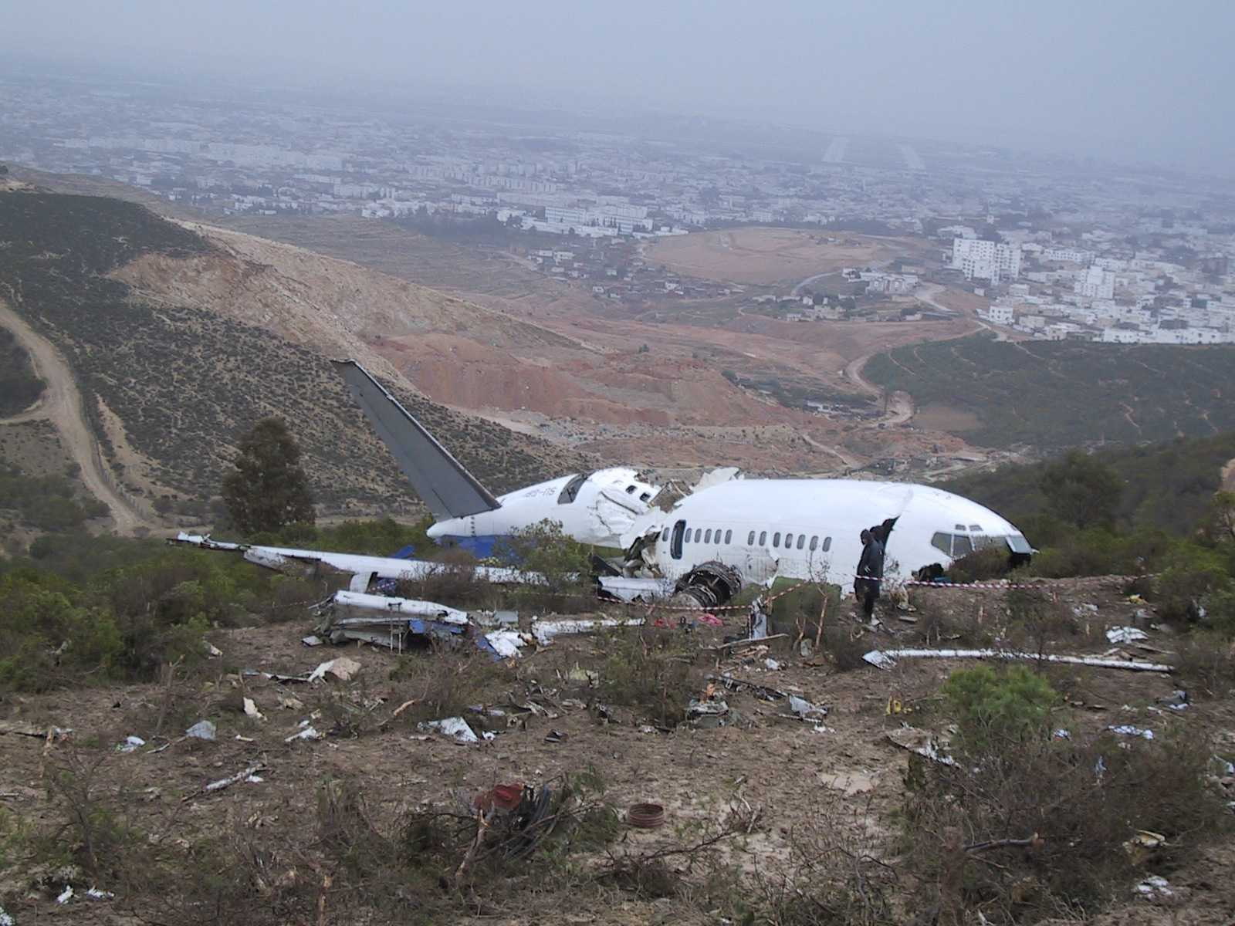
Notes:
Now let’s shift from general data to some specific high risk areas
As was the case for the last 20 years, Controlled Flight Into Terrain (CFIT), Approach and Landing, and Loss of Control accidents continue to claim the majority of our aircraft and account for the majority of our fatalities

Slide 11
Approach and Landing Major Accidents
Commercial Jets
1 January 2010 through 1 November 2010
Date | Operator | Aircraft | Location | Phase | Fatal
2 January | CAA | B-727 | Kinshasa, DRC | Landing | 0
24 January | Taban Air | TU-154 | Mashhad, Iran | Landing | 0
22 March | Avistar-TU | TU-204 | Moscow, Russia | Approach | 0
13 April | Merpati Airlines | B-737 | Rendani, Indonesia | Landing | 0
13 April | Aerounion | A-300 | Monterrey, Mexico | Approach | 5
5 May | Satena | EMB-145 | Mitu, Colombia | Landing | 0
12 May | Afriqiyah Airways | A-330 | Tripoli, Libya | Approach | 103
22 May | Air India Express | B-737 | Mangalore, India | Landing | 158
27 July | Lufthansa | MD-11F | Riyad, Saudi Arabia | Landing | 0
28 July | Airblue | A-321 | Islamabad, Pakistan | Approach | 152
28 July | Mauritania Airways | B-737 | Conakry, Guinea | Landing | 0
16 August | Aires | B-737 | San Andres, Colombia | Landing | 1
24 August | Henan Airlines | EMB-190 | Yichan, China | Approach | 42
25 August | Passaredo Linhas Airways | EMB-145 | Vitoria Conquista, Brazil | Approach | 0
24 September | Windjet | A-319 | Palermo, Italy | Landing | 0
Source: Ascend and Aviation Safety Network
Notes:
This is a listing of the approach and landing accidents for commercial jets in 2010
It is a very bad year for ALA. Normally 50 to 60%. This year is 80%.

Slide 12
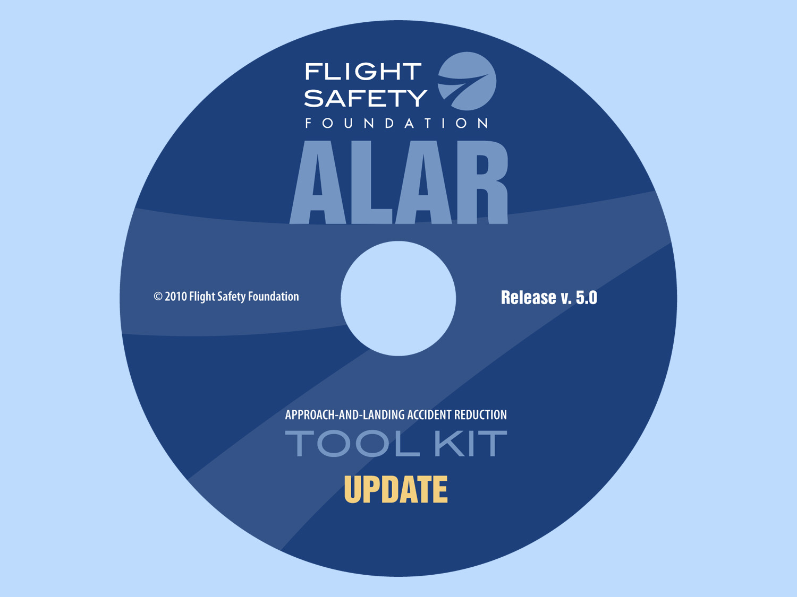
Notes:
Hopefully our updated ALAR tool kit will be able to provide tools for organizations to reduce the risk in this area.
So far this year we have conducted workshops on the updated ALAR tool kit in Manila and Libya, and ones are scheduled in Singapore and Bangkok before the end of the year.
The reason – get this important information out to those who an use it to reduce risk – and not just pilots, but ATC, Airports, and Regulators.

Slide 13
Controlled Flight into Terrain Major Accidents
Commercial Jets
1 January 2010 though 1 November 2010
Date | Operator | Aircraft | Location | Phase | Fatal
28 July | Airblue | A-321 | Islamabad, Pakistan | Approach | 152
24 August | Henan Airlines | EMB-190 | Yichan, China | Approach | 42
Sources: Honeywell (Don Bateman), Ascend
Notes:
This is a listing of the CFIT accidents for eastern and western built commercial jets so far in 2010

Slide 14

2008: 7 of 29 turboprop major accidents CFIT
2009: 7 of 21 turboprop major accidents CFIT
5 Year Running Average
Notes:
This is a graph of commercial jet CFIT accidents since 1998.
You will note that 2004 was our first (and only) year ever with 0 commercial jet CFIT accidents
The red line is a 5 year rolling average, and you can see that we are improving – but slowly.
This chart highlights that sustaining low CFIT rates has been difficult for commercial jets.
Of particular note is the commercial turboprop CFIT record:

Slide 15
Loss of Control Major Accidents
Commercial Jets
1 January 2010 through 1 November 2010
Date | Operator | Aircraft | Location | Phase | Fatal
25 January | Ethiopian Airlines | B-737 | Beirut, Lebanon | Climb | 90
12 May | Afriqiyah Airways | A-330 | Tripoli, Libya | Approach | 103
Source: Ascend, Boeing
Notes:
In 2006 loss of control accidents took over from CFIT as the leading killer in commercial aviation. – and unfortunately they are lengthening their lead.
This is a list of the loss of control accidents up to 1 November of this year.

Slide 16
Loss of Control Major Accidents
Commercial Jets
1997 through 2009
Number of Accidents
5
2
Source: Ascend, Boeing
Notes:
Here are the last 12 years of loss of control accidents
You can see there is not a consistent pattern over this time period – but we have never had a year with 0.
And of course the bad news is that almost every LOC accident, like CFIT, is not survivable – so the fatality numbers are big

Slide 17
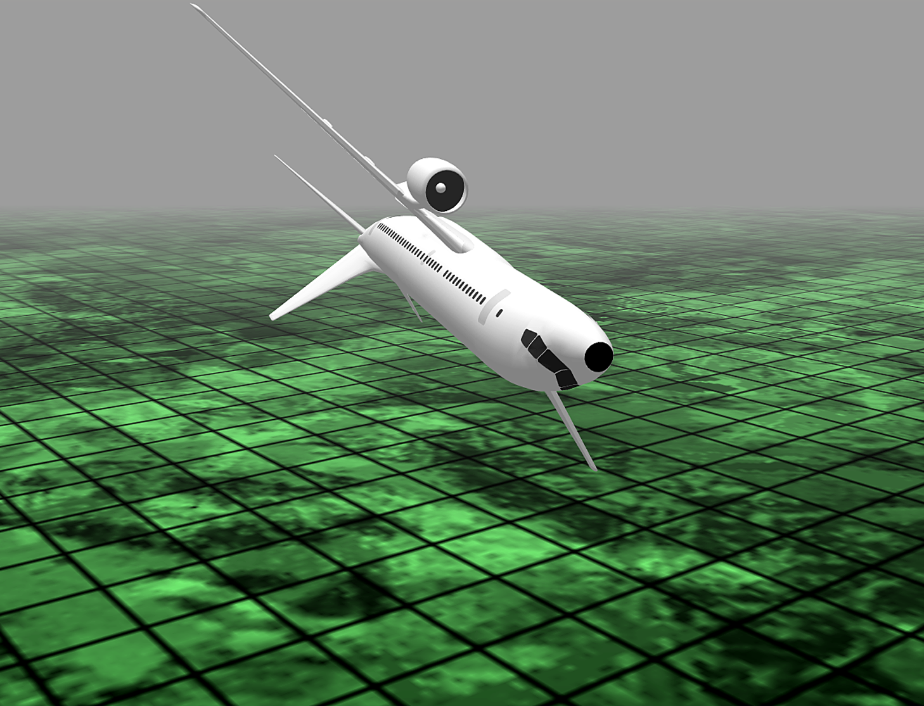
Notes:
The term for this type of accident – “loss of control” does not really describe many of the accidents themselves.
Let me give you a definition of a LOC accident:
Definition: A loss of control accident is an accident in which an aircraft is unintentionally flown into a position from which the crew is unable to recover due to either aircrew, aircraft, environmental, or a combination of these factors.
About half of recent “loss of control” accidents (8 of 18 over the last 5 years) have been what is more accurately called “lack of control” accidents because the crews had full control of the aircraft at all times.

Slide 18
Some LOC Observations
No good visual references
* IMC
* Night
* Over Water or lightless/featureless land
- Auto-Pilot involved (on or off ?)
- Initial movement imperceptible (2 degrees/sec)
- Initial correction often in wrong direction
- One of crew has good or better SA – but
wait too long to correct the situation
Notes:
Here are observations from many of the LOC accidents over the past several years
You will hear much more about loss of control and how it is being addressed later in the seminar.
Before we leave this year’s data, let me show you a very interesting set of data………..

Slide 19
Major Accidents by Decade
Worldwide Commercial Jets
1960 to 2009
Major Accidents in accidents per million departures
Notes:
This shows the improvement in the hull loss accident rate we have made over the past 5 decades since the introduction of the jet airliner
You can see we have maintained a steady decrease in the accident rate – an average improvement of 32% per decade
That means we have reduced the accident rate by an average of one third every 10 years
Even for an already safe system, that is an impressive accomplishment

Slide 20
Two Decades of Improvement
1990 – 1999 Major Accident Rate: 1.18
1990 – 1994 Major Accident Rate: 1.32
1995 – 1999 Major Accident Rate: 1.06
2000 – 2009 Major Accident Rate: .57
2000 – 2004 Major Accident Rate: .58
2005 – 2009 Major Accident Rate: .55

Slide 21
Major Accident Rate
Western-Built Commercial Jets*
1997 – 2010
Accident rate per million departures
* Reliable total departure data not available for Eastern-Built Aircraft
Source: Ascend
Notes:
This chart shows both the major accident rate in accidents per one million departures and the 5 year running average of that rate for commercial jets
Again, this chart is only for Western built aircraft since it involves rates
As you can see, the decreasing trend has leveled off.
As you know, after reviewing the yearly data, each year I discuss a safety challenge – some topic that we need to address in order to reduce risk and improve our safety performance.
This year I want to discuss………………….

Slide 22

Managing Risk
Notes:
Managing Risk
But I don’t want to talk about just managing risk – but managing risk in a high risk environment
Now there is risk in everything we do…Even pulling chocks………………

Slide 23
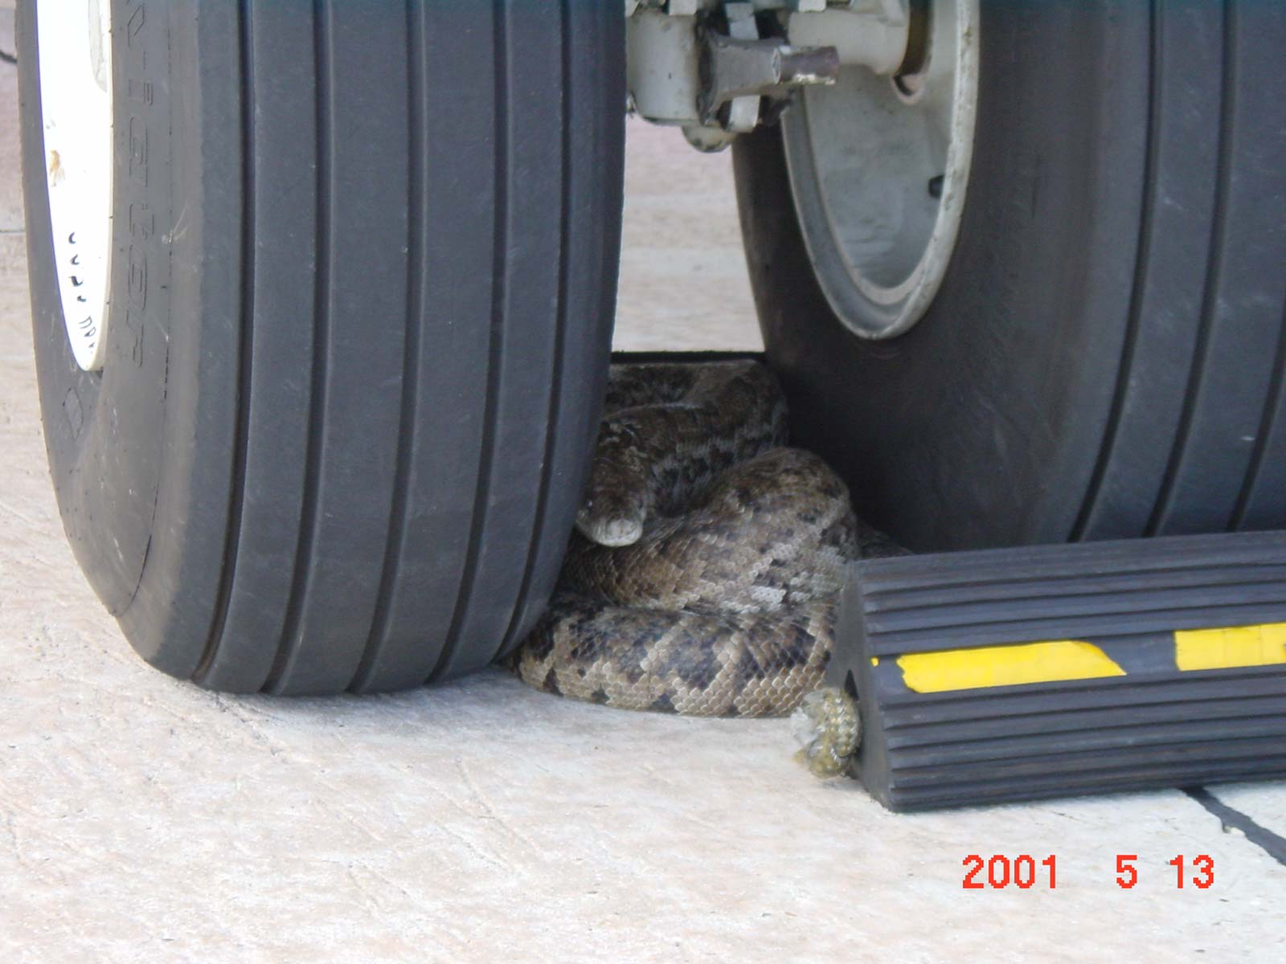
Notes:
…………………may have an element of risk
Managing risk is what safety is all about

Slide 24
Risk Management
Risk = Probability X Severity
Everything in life has risk
Manage Risk by modifying P or S
Notes:
Basics: Risk R = P x S
Everything in life has risk
Safety = Risk Mgmt (eliminate, reduce, acknowledge)
How do we do that – well we modify P or S
e.g. from our excursion work:
e.g. Modify S = put in EMAS (not effect P, just S)
Modify P = stabilized approach criteria, no-fault
go around policy. (effect P, not S)
Now some organizations manage risk very well by necessity --- because they operate in a high risk environment

Slide 25
High Relability Organizations
Managing risk is important –
critical in a high risk environment
High reliability organization =
Successful in managing high risk
- Nuclear Industry
- Oil and Gas Industry
- Medical
- Aviation
Notes:
Due to type of environment, type of operations, and particularly consequences, some organizations operate in high risk environments and risk management is critical
Most of these are also high reliability organizations
Reliability = success in managing risk
So high reliability = successful in managing high risk
Examples: Nuclear Industry
Oil and Gas Industry
Medical
and of course, Aviation
As an example, let me give you some insight into some high risk operations and a high reliability organization I know something about

Slide 26
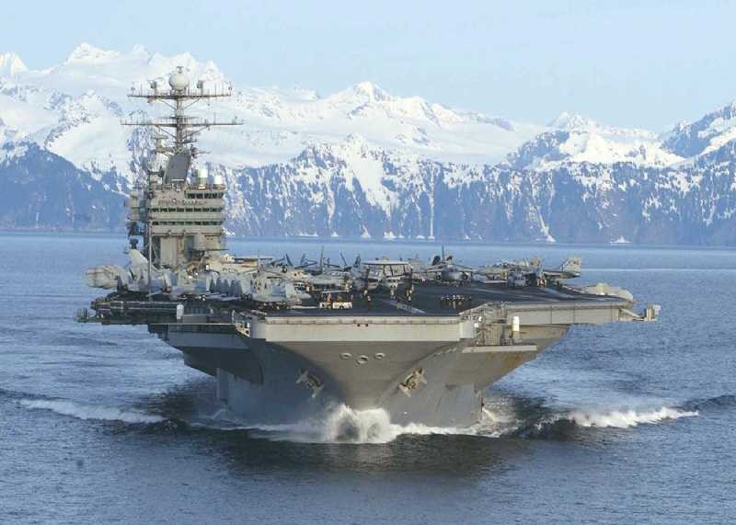
Notes:
– US Navy carrier operations
Now many just think of taking off and landing on a carrier when we talk about high risk – and I will talk about that
But just being on a carrier flight deck is high risk

Slide 27
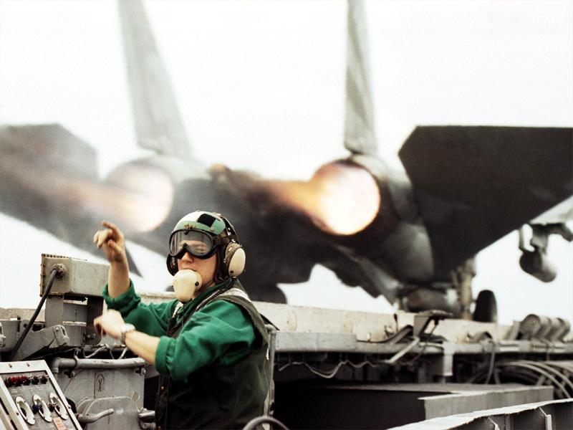
Notes:
Carrier Deck:
50 aircraft and all support equipment (including ARFF and crash & salvage) in the space of a ballroom
Aircraft taking off, landing, taxiing, maintenance being conducted, fueling going on, and ordnance being loaded interspersed throughout the area
Launch 20 aircraft in 15 minutes, then immediately land 20 aircraft in 25 minutes
Then do it all again
So high tempo of operations
in a very confined area
Ask any carrier pilot, who are normally fearless, and they will tell you that being on the flight deck of a carrier during flight operations and not being in an airplane is one of the scariest things about carrier operations

Slide 28
Carrier Operations
Takeoffs
- 0 to 170 knots in 3 Seconds
- Takeoff distance is 273 feet
- Vr is stall speed + 15 (or less)
- Every night catapult shot is the
definition of a somonagrphic
illusion
Notes:
Then we get to the flying part of carrier operations
Every night catapult shot is the definition of a somonographic illusion:
3-4 horizontal g’s due to acceleration from 0 to 170 in 3 seconds
No visual references after 3 seconds – only black of the sea
No visual references after 3 seconds – large horizontal acceleration
Can takeoff with parking brake set
- does not effect takeoff speed
- does effect tires--- normally accompanied by two “pops”

Slide 29
Carrier Operations
Landings
- 750 foot runway that is moving forward
at 25 Knots (and sometimes also
moving up and down and side to side)
- Touchdown zone is 100 feet
(there is no plus or minus)
- Immediately go to full power on landing
- Every night approach is the textbook
definition of a Black Hole approach
Notes:
Landings:
750’ runway that is moving forward at 25 knots (and sometimes moving up and down, and side to side also).
Touchdown zone is 100 feet long – and there is no plus or minus ! If you land beyond the touchdown zone, you go around.
If you land short, very bad things happen.
When you touch the deck, you immediately go to full power.
Every night approach is a textbook “black hole approach”. Only one small light source in a horizon to horizon sea of black.

Slide 30
The Ease of Carrier Operations
Never have to calculate a takeoff distance
(It is always 273 feet)
Never have to calculate V1
Never have to calculate takeoff power setting
Never have to calculate landing distance
Notes:
Now people think carrier operations are difficult – but there are some aspects that make it easier than airline operations. E.g.

Slide 31
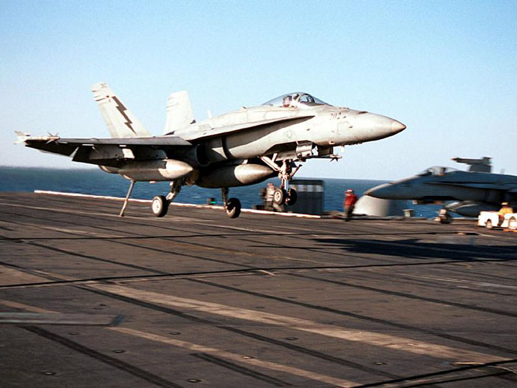
Notes:
All of this going on simultaneously, day and night, good weather and bad, in the space of this room
Eliminate the risk – I don’t think so !!
However: design, training, special equipment, and SOP enable the risk to be minimized – not eliminated, but minimized
Now I think Naval Aviation could be considered a high reliability organization
1. Operate in a high risk environment
2. Are successful in managing that risk
But how about some of the other organizations I mentioned? Here is a graphical look at them……

Slide 32
High
Nuclear Industry
Carrier Aviation
Commercial Airlines
Reliability
Good
Oil and Gas Industry
Medical
Bad
Low
Low
Risk
High
Notes:
Axes are Reliability (success in managing risk) and Risk.
Green is good, Red is not good
Just my observations – your graph may look different
So there is a variance in how successful high reliability organizations are.
However, there are some common elements to operating successfully in a high risk environment……………..

Slide 33
Keys to Success in High Risk Operations
Well developed and current procedures:
* Manuals
* SOP’s
2. Investigation of risk management failures
to prevent them from happening again
3. Sharing risk reduction information
* Investigation results
* Normal operations opportunities to reduce
risk
Notes:
The Keys:
Good procedures that are well developed and kept current:
- Manuals
- SOPs
e.g. if says check both wings and it shows a picture of the top and bottom wings – not current !!
Investigation of risk management failures
Object of investigation not for blame – for prevention
3. Sharing of information

Slide 34
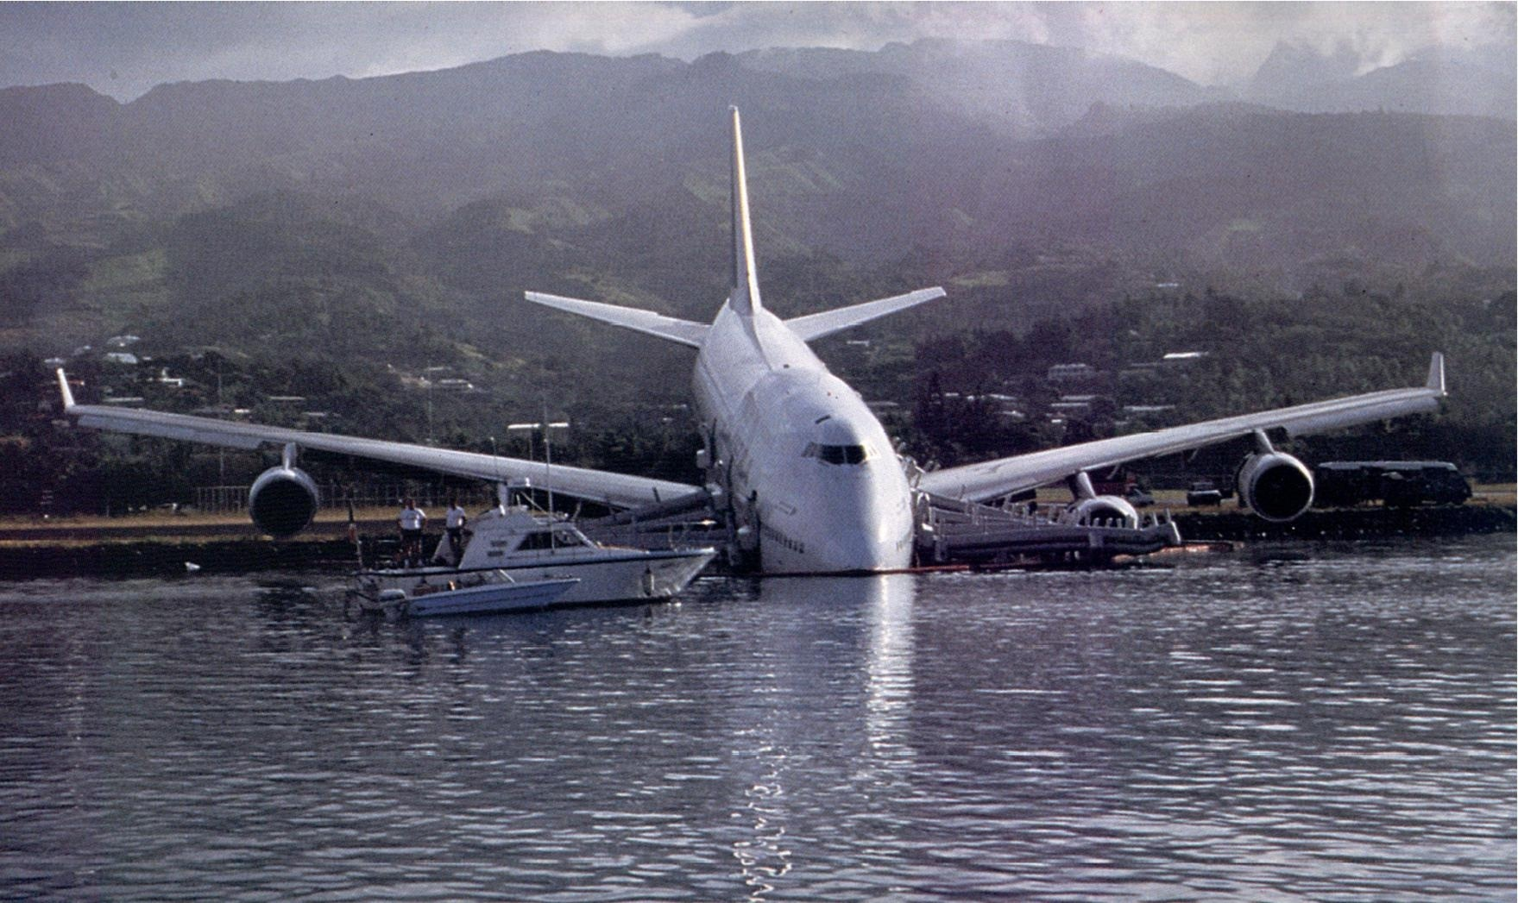
Notes:
Commercial aviation has always led the way in successfully reducing risk.
The keys I just showed you are the reason we have been successful
We need to continue our efforts
If the accident rate stays the same and the departures, as expected, increase – by simple math
we will have more accidents.
Telling the public we are a high reliability organization will not work. Telling the public that the rate is the same will not work – they don’t care about rates, they will just think that since there are more accidents it is less safe to fly

Slide 35
Aviation Safety 2010
Mediocre to below average year for commercial
jets so far
Good year (so far) for commercial turboprops
and business jets
Commercial jet loss of control accidents and
commercial turboprop CFIT’s dominate the
fatality numbers
Commercial jets have an outstanding accident
record--- but it has stopped improving
Being successful in risk reduction is important,
particularly for a high reliability organization
Notes:
In summary, this is what we have seen so far in 2010:
Commercial jets are having an average to below average year. The last two months will determine if it was mediocre or below average.
The best we can do is .55 if there are no more accidents
Commercial turboprops and business jets had very good a very good year so far
The big killers are still there – particularly loss of control in commercial jets and CFIT for commercial turboprops
Commercial jets have a great safety record – but it has stopped improving. With the expected increase in departures, we can expect more accidents even if we maintain the same rate.
Aviation has always been the leading, most visible, and most copied high reliability organization: but we need to continue to work at it to be successful.

Slide 36
FSF Goal:
Make Aviation Safer by reducing the Risk of an Accident
Notes:
This is the Foundation’s goal
We have had great success toward achieving this goal, but as we saw, there are still challenges that need to be addressed.
In an industry where the risk will never be 0, we face a constant challenge in meeting the public’s expectation of perfection as the minimum acceptable standard.
However, the aviation industry continues to successfully address that challenge and is constantly working to make aviation safer by reduce the risk of an accident

Slide 37
2010 Departures
1 July 13.75
1 Aug 16.04
1 Sept 18.33
1 Oct 20.63
1 Nov 22.92
1 Dec 25.21
31 Dec 27.50
Major Accident
1. Aircraft Destroyed, or
2. Multiple Fatalities to Occupants, or
3. One Fatality and Aircraft Substantially Damaged

