Slide 1
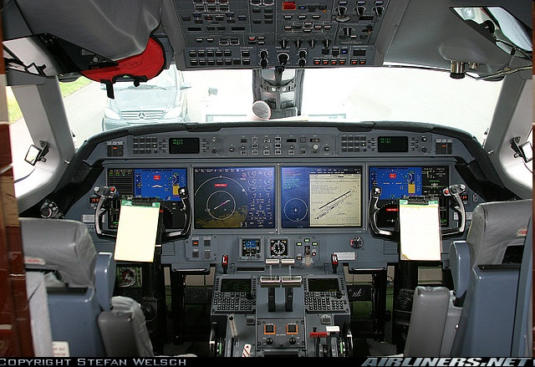
Piloting Skills over Time
A study of professional pilots and their basic instrument skills
Captain Michael Gillen
Notes:
Pilots who participated in this study did so at no jeopardy to themselves in regards to their employment status at their respective airline. Participation in the study did not count towards successfully completing the required recurrent training program.. The research study received assurances in writing from the respective airline before the study began and made this point clear to the pilots before the maneuvers were flown via a written consent form. In addition, the participating airline gave its consent to be part of the study. The pilot’s union was also notified of the study before data collection began. Pilots’ survey responses and actual performance on the maneuvers was completely de-identified to protect both the pilots and their respective company. When the data material was received, it was also completely stripped of the company identification. This was done to prevent the results from any one company being compared to any other company or ending up published in the media.

Slide 2

Introduction
With the advent of advanced, highly automated cockpits found in modern jet transport category aircraft, most of the tedious work of flying the aircraft solely by reference to raw data information from the airplane’s instruments is becoming a thing of the past.
As a result of the widespread use of automation, pilots are no longer required to use their raw data instrument skills on a daily basis. A result of this piloting style may cause a pilot’s basic instrument flying skills to deteriorate over time. In fact, most airlines today encourage the use of automation, thus adding to this possible problem.
=
Notes:
With the advent of advanced, highly-automated cockpits found in modern jet transport category aircraft, most of the tedious work of flying the aircraft solely by reference to raw data information from the airplane’s instruments is becoming a thing of the past. In fact, many of the airlines now suggest that pilots not hand fly the aircraft with the automation turned off (United, 2006).
In years past, with older style aircraft, commercial pilots were required to do a majority of instrument flying by reference to raw data instrumentation. Although flight directors were installed on these aircraft, they were seldom used and often unreliable. The net result of this type of flying produced highly competent instrument pilots.
With the increased use of automation, basic instrument skills flight may be declining. It is the purpose of this study to determine if the average jet transport pilot’s basic instrument flying skills have diminished as a function of the time spent flying technologically advanced aircraft. Research on adult literacy skills does show a decline over periods of non-use (Wagner, 1995).

Slide 3
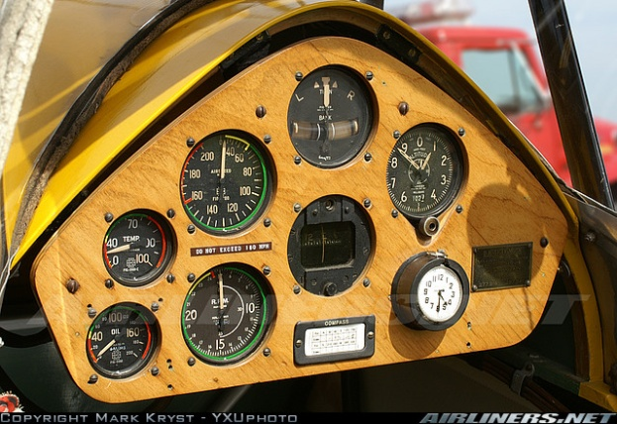
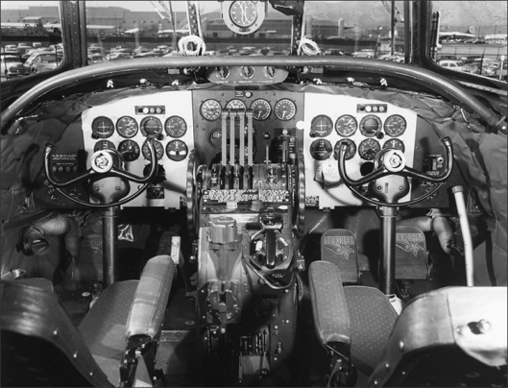
Purpose
To gain professional pilots’ self assessment of their basic instrument skills
To determine if pilots of modern glass aircraft have experienced a significant degradation of their basic instrument skills
Notes:
The purpose of this study was to gain an assessment of professional pilots’ basic instrument skills. The study used both qualitative and quantitative measures to accomplish this task.
The hypothesis for this study was that with the advent of advanced aircraft, a pilot’s basic instrument flying skills will diminish over time, and will no longer be at the level required when they received their ATP license. The two research questions were to what extent degradation in basic instrument pilot skills occurs, and can this degradation be statistically proven?
The piloting style of highly automated jet transport category aircraft may cause a commercial airline pilots’ basic instrument flying skills to diminish over time. In fact, a recent research study asked pilots to evaluate their own instrument skills (Advanced Aircraft Technology Safety Survey Report, 1998). A majority of pilots responded that they believed their skills have diminished. In the survey 85% of respondents stated that they preferred to hand-fly part of every trip to retain their pilots skills. In addition, 43% pilots considered that their manual flying skills had declined since they started flying advanced technology aircraft.

Slide 4
Research Questions
What are professional pilots perceptions of their own instrument skills?
To what extent has degradation in basic instrument piloting skills occurred in pilots of advanced modern jet aircraft?
Can this degradation be statistically proven by comparing pilots against the FAA certification standards?
Notes:
Certain failures in highly automated aircraft can cause complete loss of the auto-throttles, flight director, and moving map display, thus forcing the pilots to revert to their basic instrument flying skills. If a significant decline in basic instrument flying skills is observed as a function of time spent flying technologically advanced aircraft, then a potential safety risk exists. If any degradation of skills can be empirically documented and proven, airlines can use this study to develop specific training programs and guidelines to improve basic instrument flying skills. In addition, guidance can be derived and given to professional flight crews on how to maintain their instrument skills during regular line operations.

Slide 5
Assumptions
1. Each participant is a qualified FAR pt 121 jet transport pilot employed by a US carrier (passenger or cargo).
2. Each participant has spent at least one year in the specific seat and type of aircraft. It is assumed that after one year of experience on a particular aircraft, that the pilot will be both comfortable and accustomed to flying that particular aircraft (the aircraft will not be “new” to them).
3. Each pilot is current and qualified in the respective aircraft.
4. Each pilot is considered a line pilot.
5. The pilots have no prior knowledge or practice of the maneuver that is to be flown and is given no opportunity to practice it beforehand.
6. Each pilot is assumed to fly to the best of their ability during the maneuver.
7. Each Check Airman will rate the maneuvers on a consistent basis after receiving specific rater reliability training.
Notes:
The study could be subject to inter-rater reliability errors of the individual instructors who evaluated the maneuvers.
The study did account for pilots who fly additional aircraft outside of their respective company which in many cases would be traditional style aircraft. The study asked in the survey if the pilot is flying outside of his/her professional employment.
This study was not designed to specify what, if any, additional training would be required to maintain these instrument flying skills (that will be a follow on study). The study recorded how long it has been since a pilot has flown in a professional capacity using “raw data”, and this in turn may lead to some insight as to how long these skills remain active.
The study tested only five maneuvers to determine the level of piloting skills and is only representative of a pilot’s basic instrument skills, and not their overall piloting skills.
This study is applicable to jet transport pilots of US carriers only.
The study does not account for the fact that most of the pilots of widebody glass aircraft spent many years flying traditional aircraft, and conversely the junior first officers of narrow body aircraft may have mainly flown advanced aircraft. Some studies do indicate that skills learned and extensively practiced will be maintained and recalled at a higher rate than those skills briefly learned and utilized. (Argote, 1998).

Slide 6
Sampling
The study used data from airline pilots employed by a major US Air Carrier.
  Five basic instrument maneuvers were flown 30 times by a pilot group.
  The pilots were categorized by they type of aircraft they fly and fall into the following categories:
    Pilots of long-haul wide-body aircraft (B777, B747-400 A330, A340).
    Pilot of narrow-body short haul aircraft (B737-300, A320, B757)
Each pilot was requested to complete a survey on their assessment of their own skills and general practices.
Notes:
The two pilot groups were each chosen due to the fact that they should show significantly different results. Narrow body pilots have a greater frequency of takeoffs and landings than those of wide-body aircraft. This frequency may add to a pilot flying proficiency. In addition, most wide-body aircraft rely heavily on automation due to the long duration of their flights. The study took both type of aircraft and frequency of flying into account.
There were 30 total pilots from a variety of backgrounds in the study. The number of pilots was chosen in order to gain a statistically significant sample approximating the skill level of the general professional pilot population. Each pilot group was compared using an independent samples t-test against the FAA proficiency standard with specific emphasis placed on the comparison between narrow-body and wide-body aircraft. This was done in an attempt to prove that there is a statistical difference between these pilots. Post hoc tests were performed on the different maneuvers sets to determine if the complexity of the maneuver affected the pilot’s ability to successfully fly them. If the study hypothesis is correct the pilots of the modern aircraft should show a significant statistical difference as compared to the standard pilot performance as defined by the FAA.
A summary of perceived instrument skills in each category was compared to the actual first look data results to see if there was any correlation between perceived piloting skills and actual performance.

Slide 7
Data Collection
Quantitative Study (Survey)
  Survey of participating pilots was given at the beginning of the recurrent training event
    Pilots experience
      Flying older generation aircraft (non-glass)
      Flying newer generation aircraft (glass)
      Years since flying older generation aircraft
    Pilots perceptions of their instrument skills
Qualitative Assessment
  Data on pilots seat position (Capt/FO) and experience
  Maneuver rated on 1-5 scale by check pilot
Notes:
This study was a mixed methodology study focusing on two aspects of basic instrument flying. First a qualitative survey was given to pilots to gauge their perception of their own instrument skills. The second part of the study required the use of first look data (data from maneuvers flown without pre-briefing or practice) from participating airlines and was quantitative in nature.
Each pilot of the flight crew flew five basic instrument maneuvers (in the simulator) without any prior practice or briefing. The captain and first officer each started with a different maneuver (starting maneuver was based on the day of the week). The maneuvers were evaluated in accordance with standard airline industry grading criteria and were represented as a numerical rating.
The data was completely de-identified and the maneuvers were non-jeopardy to the flight crew. The independent variable for the quantitative part of the study was the type of aircraft that pilots were flying, and the dependent variable was their basic instrument skill level.

Slide 8
Grading Scale
Table 1. Grading Scale
Five Point Grade Scale | 5 | The pilot remained well within airline standards and performance was exemplary.
 | 4 | The pilot remained within airline standards. Pilot flew to ATP instrument standards
 | 3 | The pilot committed minor deviations from airline standards that were promptly corrected. Basic instrument level.
 | 2 | Major deviations (full scale deflection) for greater than 10 seconds
 | 1 | The pilot committed major deviations from airline standards that were not promptly corrected and/or were unsafe; or was unable to perform the maneuver/task without assistance. Crash or loss of aircraft control.
Notes:
The quantitative portion of the study was a quasi-experimental design with no formal control group. The first look data was obtained from a maneuver set comprised of: a takeoff, ILS approach, holding, missed approach, and an engine failure at V1. These maneuvers were flown without the use of auto-throttles, a flight director, or the FMC/map. They were flown solely be reference to raw data (heading, airspeed, attitude, and vertical speed instruments only). The first maneuver flown first was based on the day of the week.
For the maneuvers, the study used the airline’s check pilots who certify maneuvers for the FAA during recurrent training. The check pilots (check airmen) rated each maneuver based upon the observed performance of the pilot.

Slide 9
Data Analysis
Maneuver Assessment
  Independent Samples t-test comparing all groups
    Experience vs. maneuvers
    Wide-body vs. narrow body pilots
    Pilots as a whole vs. FAA standard
  Correlation between the maneuver rating for the group of pilots vs. their overall instrument self assessment (from the survey)
Notes:
The study used data from airline pilots employed by US carriers during their recurrent training cycle. All of the subjects were active pilots employed by a major US air carrier (the carriers are not identified). Each pilot was either a Captain or First Officer and had flown their particular aircraft for at least one year. The average experience level was 7.1 years with a range from 2-16 years. There were 17 Captains and 13 First Officers, in addition, there were 18 narrow-body and 12 wide-body pilots.
Pilots were also separated by the type of aircraft that they were assigned to, either wide-body (B747, B777, DC-10) or narrow-body (B737, A320, MD-80). The pilots were separated in order to determine if there were any statistical differences between these groups

Slide 10
Results - Experience
The first test that was performed was a series of independent samples t-test that compared self-reported experience with glass and non-glass aircraft along with the time since flying a non-glass aircraft.
Pilots were divided into either narrow-body or wide-body pilots.
Notes:
The first survey tests that were performed were a series of independent
samples t-tests that compared self-reported experience with glass and non-glass
aircraft along with the time since flying a non-glass aircraft as a function of type of
aircraft flown. These results were further analyzed by the specific survey
responses relating to pilot experience.

Slide 11
Experience
Table 2. Experience Independent Samples t-test Results
 | Type of aircraft | N | Mean | Std. Deviation | t | Sig. –(2 tailed)
Years since flying a non-glass aircraft | Narrow-body | 18 | 3.50 | .857 | .301 | .765
 | Wide-body | 12 | 3.42 | .515
Years flying a non-glass aircraft | Narrow-body | 18 | 2.33 | 1.328 | .903 | .374
 | Wide-body | 12 | 1.92 | 1.084
Years flying a glass aircraft | Narrow-body | 18 | 3.89 | .323 | 2.591 | .015
 | Wide-body | 12 | 3.42 | .669
Notes:
Actual test results from the study.

Slide 12
Experience Survey Results
56% of the pilots had either never flown a non-glass aircraft or it had been greater than 10 years since they had done so.
46% indicated that they had two years or less flying non-glass aircraft.
73% of the pilots indicated that have 10 or more years flying newer generation aircraft.

Slide 13
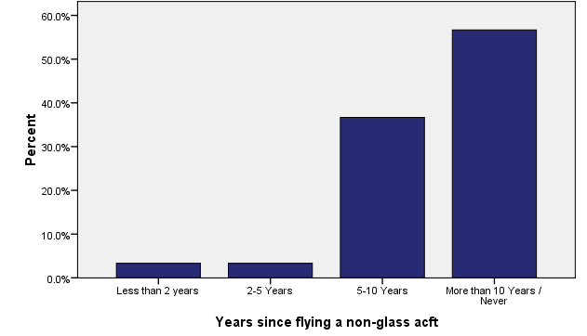
Experience – Years Since Flying a NGA
56% of the pilots had either never flown a non-glass aircraft or it had been greater than 10 years since they had done so.
Notes:
A majority of these types of aircraft are being retired, and as a result, the survey indicated that over 56% of the pilots had either never flown a non-glass aircraft or it had been greater than 10 years since they had done so. The next category 5-10 years held 36 % of the pilots with 3% each for less than two years and 2-5 years.

Slide 14
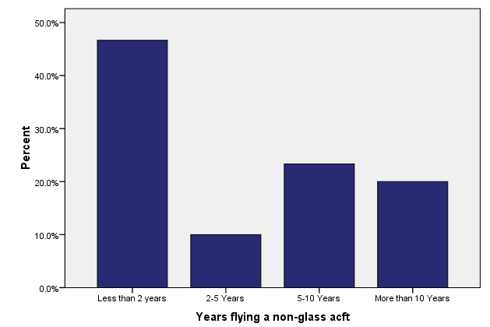
Years Flying a NGA
46% indicated that they had two years or less flying non-glass aircraft.
Notes:
The next survey question sought to quantify how much experience pilots had flying non-glass aircraft in airline operations. The results are presented in figure 2. The scale was the same as for the first question. The highest percentage of pilots (46%) indicated that they had two years or less flying non-glass aircraft. Pilots with 5-10 years experience were 23% of the sample, with 20% having more than 10 years.

Slide 15
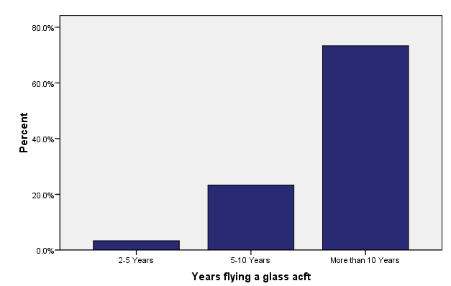
Years Flying a Glass Aircraft
73% of the pilots indicated that have 10 or more years flying these types of aircraft.
Notes:
Pilots were then asked how may years they have been flying glass aircraft. In this question, 73% of the pilots indicated that have 10 or more years flying these types of aircraft. The next highest response was 5-10 years which accounted for 23% of the responses. There were no pilots in the survey that indicated that they had two years or less flying glass aircraft.

Slide 16
Experience
The analysis revealed no significant difference in the years since flying a non-glass aircraft or in the years of experience flying a non-glass aircraft between narrow body and wide body pilots.
However, the analysis indicated that Narrow-Body Pilots reported flying glass aircraft significantly longer than wide body pilots
Notes:
The analysis revealed no significant difference in the years since flying a non-glass aircraft or in the years of experience flying a non-glass aircraft between narrow body and wide body pilots. However, the analysis indicated that Narrow-Body Pilots reported flying glass aircraft significantly longer than wide body pilots. These results were further analyzed by the specific survey responses relating to pilot experience. In the case of years since pilots had flown a non-glass aircraft there were very few pilots with recent experience.

Slide 17
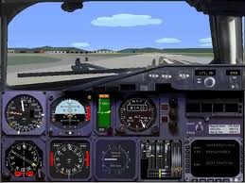
Self Assessment
The survey asked the pilots to asses their own their basic instrument skills.
Self assessment of flying skills as a function of aircraft type flown was also analyzed using a series independent samples t-tests.
Notes:
The next section of the survey asked the pilots to asses their basic instrument skills. Self assessment of flying skills as a function of aircraft type flown was also analyzed using a series independent samples t-tests.
This test again revealed no significant difference between narrow body and wide body pilots in how they assessed their flying skill.

Slide 18
Self Assessment Results
This test revealed no significant difference between narrow body and wide body pilots in how they assessed their flying skill.
Table 3. Self Assessment Independent Samples t-test Results
 | Type of aircraft | N | Mean | Std. Dev. | t | Sig. (2-tailed)
Hand flying below 10,000 feet | Narrow-body | 18 | 1.28 | .575 | .585 | .563
 | Wide-body | 12 | 1.17 | .389
Ability to fly maneuvers | Narrow-body | 18 | 1.56 | .511 | 1.183 | .247
 | Wide-body | 12 | 1.33 | .492
Skills have declined over time | Narrow-body | 18 | 2.06 | .873 | .774 | .445
 | Wide-body | 12 | 1.83 | .577
Comfort flying raw rata | Narrow-body | 18 | 2.11 | .676 | -.233 | .817
 | Wide-body | 12 | 2.17 | .577
Often practice raw data skills | Narrow-body | 18 | 1.89 | .758 | .201 | .842
 | Wide-body | 12 | 1.83 | .718
Company encourages hand flying | Narrow-body | 18 | 2.00 | .767 | -.831 | .413
 | Wide-body | 12 | 2.25 | .866
Notes:
Actual test results with size, mean, standard deviation, and t scores.

Slide 19
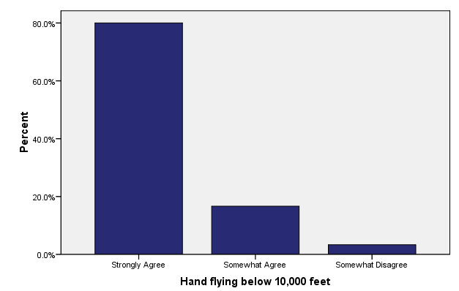
Hand Flying Below 10,000
80% of the pilots strongly agreed that they usually hand flew the airplane below 10,000 feet.
16% of pilots somewhat agreed with the statement
Notes:
Survey questions were presented in the form of a statement to which the pilot responded in terms of; strongly agree, somewhat agree, somewhat disagree, and strongly disagree. The first statement was “I usually hand fly the aircraft below 10,000 feet.” This statement was used in order to gain a perspective of how many pilots were actively flying the aircraft.
A great majority of aircraft maneuvering for both takeoff and landing occur below 10,000 feet. Above this altitude most of the flying is in the cruise phase of flight with little maneuvering. As such, a pilot will retain a maximum amount of skill by routinely hand flying below this altitude.
The survey responses indicated that 80% of the pilots strongly agreed that they usually hand flew the airplane below 10,000 feet. In addition 16% of pilots somewhat agreed with the statement. This indicates that a majority of pilots are hand flying the airplane in the maneuver intensive phases of flight. It does not however indicate if they are using all of the aircraft’s advanced capabilities or flying by “raw data”.

Slide 20
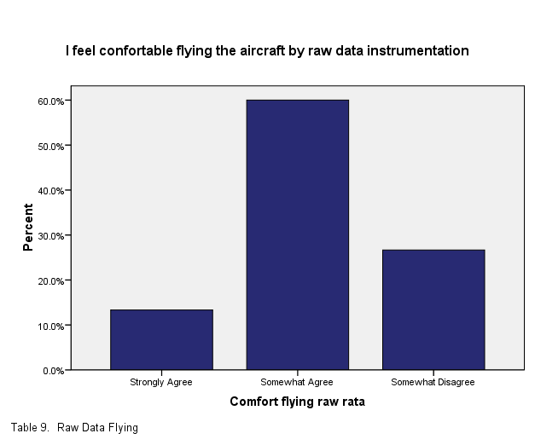
Comfort Flying Raw Data
pilots strongly agreed with this statement only 13% of the time.
60% stating that they somewhat agreed.
26% of the pilots somewhat disagreed with the statement.
These responses indicate that a majority of pilots (86%) have some reservations about flying solely by raw data
Notes:
The next statement asked pilots if they felt confident flying by raw data alone. The results indicated that pilots strongly agreed with this statement only 13% of the time with 60% stating that they somewhat agreed. A total of 26% of the pilots somewhat disagreed with the statement. These responses indicate that a majority of pilots (86%) have some reservations about flying solely by raw data as indicated by the lack of “strongly agree” responses.

Slide 21
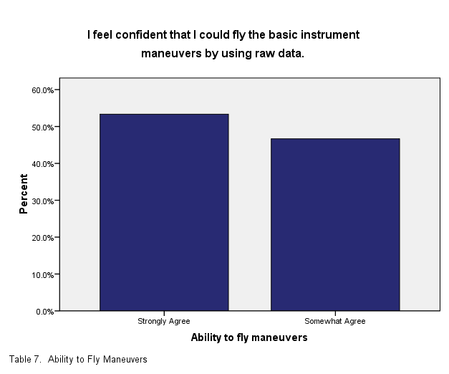
Maneuver Flying Ability
53% of pilots strongly agreed
47% somewhat agreed
Indicates that the pilots believed that they could fly these maneuvers although with a decreased skill level
Notes:
In response to the statement “I could fly a takeoff, V1 cut, ILS, and a missed approach using only raw data,” 53% of pilots strongly agreed and 47% somewhat agreed
This indicates that the pilots believed that they could fly these maneuvers although not perfectly as indicated by the somewhat agree response. There were no pilots who disagreed with the statement.

Slide 22
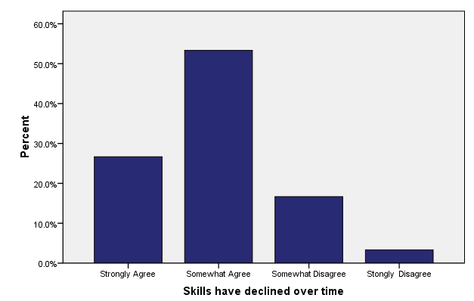
Skills Declining Over Time
Pilots agreed with this statement 26% of the time
Somewhat agreed 53% of the time.
Only one pilot strongly disagreed with the statement
16% of the pilots somewhat disagreed with the statement.
This indicates that a majority of the pilots feel that their skills have somewhat diminished over time.
Notes:
Pilots were asked if they believe that their basic instrument skills have declined over time . Pilots agreed with this statement 26% of the time and somewhat agreed 53% of the time. Only one pilot strongly disagreed with the statement, however 16% of the pilots somewhat disagreed with the statement. This indicates that a majority of the pilots feel that their skills have somewhat diminished over time.

Slide 23
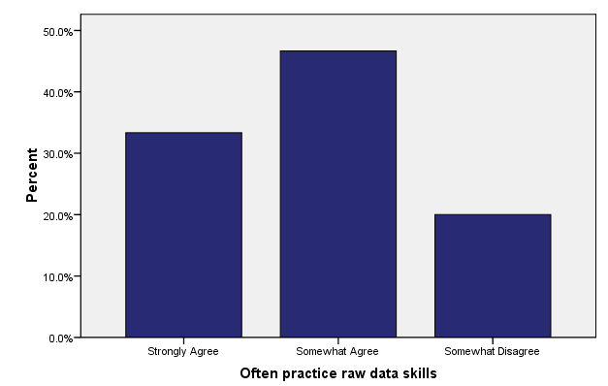
Basic Instrument Skill Practice
33% strongly agreed
46% somewhat agreed
Pilots somewhat disagreed with the statement 20% of the time.
This statement indicates that a majority of pilots are doing at least some basic instrument flying.
Notes:
The final survey statement asked whether pilots believed that their company encourages hand flying. This statement saw a wide range of opinions. It is the author’s experience and anecdotal opinion that companies who encourage hand flying generally have pilots who choose to hand fly more often. Pilots agreed with this statement 20% of the time and somewhat agreed 57% of the time. Pilots somewhat disagreed 16% of the time and strongly disagreed 7% of the time.

Slide 24
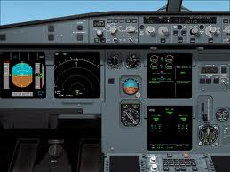
Hand Flying Assessment
The next part of the study sought to gauge the subjects ability to hand-fly the airplane with only basic instrument functionality
The maneuvers were rated against the FAA standards for an ATP license
Analysis was performed on wide-body pilots, narrow- body pilots and the group as a whole.

Slide 25
Maneuvers as a Function of Aircraft
Analyses revealed no significant differences between wide-body and narrow body pilots in their performance on the individual maneuvers or on a composite measure.
Table 4. Mean Maneuver Ratings
 | Type of aircraft | N | Mean | Std. Deviation | t | Sig. (2-tailed)
Takeoff Maneuver | Narrow-body | 18 | 3.2222 | .94281 | .158 | .875
 | Wide-body | 12 | 3.1667 | .93744
V1 Cut Maneuver | Narrow-body | 18 | 3.0556 | .72536 | .204 | .840
 | Wide-body | 12 | 3.0000 | .73855
Holding Maneuver | Narrow-body | 18 | 2.4444 | .85559 | .607 | .549
 | Wide-body | 12 | 2.2500 | .86603
ILS Maneuver | Narrow-body | 18 | 3.0556 | .80237 | .731 | .471
 | Wide-body | 12 | 2.8333 | .83485
Missed Approach | Narrow-body | 18 | 3.1667 | .70711 | 1.157 | .257
 | Wide-body | 12 | 2.9167 | .28868
Mean of Maneuvers | Narrow-body | 18 | 2.9889 | .46259 | .900 | .376
 | Wide-body | 12 | 2.8333 | .46580
Notes:
Actual test results from the study. Note that the [Sig} column of this graph indicates that there were no statistical differences between narrow-body and wide body pilots. In order to be considered significant the results would equal or less that .05.

Slide 26
Performance vs. FAA Standard
Analyses were computed to test whether the maneuver ratings (ignoring aircraft type) were significantly different from the FAA standard of 4
Table 5. Maneuver Means
 | N | Mean | Std. Deviation | Std. Error Mean
Takeoff Maneuver | 30 | 3.2000 | .92476 | .16884
V1 Cut Maneuver | 30 | 3.0333 | .71840 | .13116
Holding Maneuver | 30 | 2.3667 | .85029 | .15524
ILS Maneuver | 30 | 2.9667 | .80872 | .14765
Missed Approach | 30 | 3.0667 | .58329 | .10649
Notes:
A final set of analyses were computed to test whether the maneuver ratings (ignoring aircraft type) were significantly different from the FAA standard of 4.
A t-test reveled that the pilots in the study flew the five basic instrument maneuvers well below the FAA standards. Significant t scores were noted for all maneuvers.

Slide 27
Performance vs. FAA
One-Sample Test
 | Test Value = 4
 | t | df | Sig. (2-tailed) | Mean Difference | 95% Confidence Interval of the Difference
 |  |  |  |  | Lower | Upper
Takeoff Maneuver | -4.738 | 29 | .000 | -.80000 | -1.1453 | -.4547
V1 Cut Maneuver | -7.370 | 29 | .000 | -.96667 | -1.2349 | -.6984
Holding Maneuver | -10.521 | 29 | .000 | -1.63333 | -1.9508 | -1.3158
ILS Maneuver | -6.998 | 29 | .000 | -1.03333 | -1.3353 | -.7314
Missed Approach | -8.764 | 29 | .000 | -.93333 | -1.1511 | -.7155
Notes:
The results indicate that the study pilots flew the maneuvers closer to a basic instrument level instead of the FAA standard for Airline Transport Pilots (ATP). The holding maneuver received the lowest grade 2.4 and the takeoff had the highest at 3.2. Takeoffs are largely performed by reference to raw data instrumentation whereas holding is rarely if ever performed in such a manner.
Specific emphasis should be placed on the Sig. column. Essentially is indicates the probability that chance alone could explain the results. The generally accepted academic standard is that if there is less that a 5% probability that chance alone created the results, the sample is considered statistically significant.

Slide 28
Findings (FAA Standard – ATP)
The mean for each maneuver was compared to the FAA certification standards for both the Airline Transport Pilot (ATP) certificate and the Instrument rating.
t-test reveled that the pilots in the study flew the five basic instrument maneuvers well below the FAA standards
  Significant t scores were noted for all maneuvers.
  Score is considered significant if it is less than .05
Notes:
The study found that professional pilots have a significant decline in their basic instrument skills. The mean for each maneuver was compared to the FAA certification standards for both the Airline Transport Pilot (ATP) certificate and the Instrument rating. An ATP certificate is required to be a Captain for a major airline. The certification standards are defined in the FAA’s Practical Test Standards. All of the maneuvers were graded below the FAA certification standard for an ATP certificate (4) and in fact a majority of the maneuvers were rated at or below what is required for basic instrument certification (3). The lowest rated maneuver was holding that was graded at 2.4. This is well below the basic instrument certification grade (3). The highest rated maneuver was the takeoff, graded at 3.2. There were two maneuvers graded below three and three maneuvers graded above three.

Slide 29
Findings
  The ATP certification standards are defined in the FAA’s Practical Test Standards.
  All of the maneuvers were graded below the FAA certification standard for an ATP certificate (4) and in fact a majority of the maneuvers were rated at or below what is required for basic instrument certification (3).
  The lowest rated maneuver was holding that was graded at 2.4. This is well below the basic instrument certification grade (3).
  The highest rated maneuver was the takeoff, graded at 3.2.
  There were two maneuvers graded below three and three maneuvers graded above three.

Slide 30
Findings
Pilots who volunteered had an average of over seven years of experience flying their particular aircraft.
  73% of the pilots have over 10 years of experience flying newer-generation glass aircraft.
  47%, had two years or less flying a non-glass aircraft in commercial service.
80% of the pilots surveyed agreed that their basic instrument skills have declined over time.
  However, when asked if they could fly the basic instrument maneuvers with reference to raw data only, 100% of the pilots surveyed stated that they could.
  60% of the pilots agreed with the statement that they feel comfortable flying by reference to raw data only.
  Pilots (80%) also indicated that they often practice their raw data skills.
Notes:
The study also found through survey responses that the pilots who volunteered had an average of over seven years of experience flying their particular aircraft. In addition, the study found that 73% of the pilots have over 10 years of experience flying newer-generation glass aircraft. The majority of pilots, 47%, had two years or less flying a non-glass aircraft in commercial service.
The survey also found that 80% of the pilots surveyed agreed that their basic instrument skills have declined over time. However, when asked if they could fly the basic instrument maneuvers with reference to raw data only, 100% of the pilots surveyed stated that they could. In addition, 60% of the pilots agreed with the statement that they feel comfortable flying by reference to raw data only. Pilots (80%) also indicated that they often practice their raw data skills.
Narrow-body and wide-body pilots were examined to see if there was any significance between maneuver means for these two groups. There was no statistical difference between these two groups for the basic instrument maneuvers.

Slide 31
Findings
The study found that professional pilots have a significant decline in their basic instrument skills.
The study also found that in general pilots are not aware of this skill degradation
Notes:
Analysis of the above data strongly suggests that pilots of advanced glass aircraft have experienced a significant decline in their basic instrument skills. All of the maneuvers that were sampled were graded below the FAA certification standard for an Airline Transport Pilot. In addition, the survey indicates that pilots are aware that their skills have declines, but still believe that they could successfully fly these maneuvers. Lack of recent basic instrument flying experience is very high in flying glass aircraft which has lead to the decline in raw data skills.

Slide 32
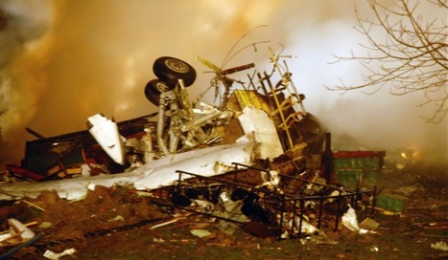
Significance
Recent accidents suggest that in some cases pilots are not performing well in time critical/demanding situations. This suggests lack of recent skill use combined with over-reliance on the auto-flight systems.
  DH8D BUF, NY
  B737, AMS
  A320, Pakistan
Notes:
The National Transportation Safety Board determines that the probable cause of this accident was the captain’s inappropriate response to the activation of the stick shaker, which led to an aerodynamic stall from which the airplane did not recover. Contributing to the accident were (1) the flight crew’s failure to monitor airspeed in relation to the rising position of the low-speed cue, (2) the flight crew’s failure to adhere to sterile cockpit procedures, (3) the captain’s failure to effectively manage the flight, and (4) Colgan Air’s inadequate procedures for airspeed selection and management during approaches in icing conditions.
Dutch investigators indicated a malfunctioning altitude indicator combined with inattentive pilots resulted in the fatal crash of a Turkish Airlines jet approaching Amsterdam's Schiphol Airport, sparking new concerns about the issue of cockpit complacency.

Slide 33
Significance
Certain technical failures in advanced glass aircraft can significantly degrade cockpit instrumentation and/or automation performance.
  When these failures occur, pilots are required to use their basic instrument skills to safely fly the airplane.
Pilots who are competent in basic instrument flying enhance their overall flying skills. They can devote less attention to physically flying the airplane and more time managing their environment.
Notes:
Automation Bias
A study titled Automation Bias: Decision Making and Performance in High-Tech Cockpits sought to quantify the effects of automation over-reliance in modern cockpits. This study pointed out the need for pilots to be able to fly the airplane when the automation does not function correctly. Automation is assuming increasing control of cognitive flights tasks, such as calculating fuel efficient routes, navigating, or detecting and diagnosing system malfunctions and abnormalities (Mosier, 1998). Highly automated cockpits tend to change the way pilots perform tasks and make decisions. Researchers have documented problems in the use of advanced automated systems, including mode misunderstanding, failures to understand automated behavior, confusion or lack of awareness concerning what automated systems are doing and why, and difficulty tracing the functioning or reasoning process of automated agent (Billings, 1996; Sarter and Woods, 1993).
When automated aids are introduced, the pattern of cue utilization is disrupted. Automated aids present powerful and usually highly accurate cues. In fact, computational system diagnostic capabilities are advertised as being more accurate than pilots. This leads to the overall attitude that the automated cues are not just another cue, but the most powerful and important cue. These automated decision aids feeds into the general human tendency to travel the road of least cognitive effort. Typically people try to engage in the least amount of cognitive work they can get away with (Fiske and Taylor, 1994).

Slide 34
Significance
Although most pilots in the study agreed that their instrument skills have declined over time, their survey responses indicated that they felt they could still fly the basic instrument maneuvers.
  The survey responses related to skills do not correlate with the actual maneuver grades.
  This leads to the conclusion that pilots in the study believed that they could fly the maneuvers better than they actually could leading to a false sense of confidence.
Notes:
Skill Retention Literature Review:
The opportunity for pilots to practice and maintain their skills has decreased significantly over time (Advanced Aircraft Technology Safety Survey Report, 1998). Airline polices, advanced automation, and increased long haul flying has all added to this decreased opportunity to manually fly the airplane. “Forty-three per cent of pilots considered that their manual flying skills had declined since they started flying advanced technology aircraft.” (Advanced Aircraft Technology Safety Survey report, 1998, page 29). Most pilots hand-fly their aircraft at some stages of each flight to maintain an acceptable skill level. Anecdotal evidence indicates that the main reasons for this are a pilot’s natural satisfaction in performing manual flying tasks, the requirement to perform manual flying exercises during simulator sessions (including recurrent training and license renewal) and the need to be able to manually fly the aircraft should the automated systems fail to function as expected. It would appear that the attempts of both the pilots and their airlines have not succeeded in maintaining a perceived level of manual skills. Of concern are pilots who continue to manually control an aircraft with a diminishing level of skill. This has been recognized by some airlines who have implemented supplementary simulator programs to compensate for a perceived loss of manual flying skills (Advanced Aircraft technology Safety Survey Report, 1998).

Slide 35
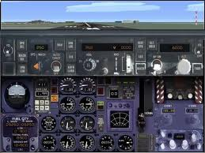
Correlation
The maneuver grades generally fit with what the literature review revealed in other related studies.
  Earlier studies indicated that skills when not used decline over time. This was observed throughout the study in the mean maneuver grades.
Survey responses, although candid about skills declining over time, did not correlate with maneuver grades or responses to earlier surveys on the same subject.
  Pilots who participated in the study believed that their skills had not declined as much as indicated by the maneuver grades.
Notes:
The maneuver grades generally fit with what the literature review revealed in other related studies. Earlier studies indicated that skills, when not used, decline over time. This was observed throughout the study in the mean maneuver grades. Earlier studies also suggest that pilots who fly advanced glass aircraft see a general decline in their basic instrument skills as a result of using the instrumentation features of these aircraft.
Survey responses, although candid about skills declining over time, did not correlate with maneuver grades or responses to earlier surveys on the same subject. It would seem as though the pilots who participated in the study believed that their skills had not declined as much as indicated by the maneuver grades.
The suggestion by earlier studies that once a skill set was learned and practiced over a long period of time it would be retained longer than if the skills were practiced over a shorter period of time. This was not seen in the wide-body / narrow-body within groups comparison. Pilots of the wide-body aircraft had more experience flying older-generation aircraft than the narrow-body pilots, but had very similar maneuver grades. In fact there was no statistical difference between maneuver grades for these two groups. This is most likely due to the fact that although narrow-body pilots fly similar monthly hours, they fly far more cycles than wide-body pilots. This leads in a significant increase in maneuvering the aircraft and thus increased flying skills.

Slide 36
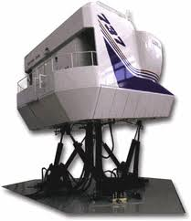
Future
Each professional pilot was highly competent in these skills at one time during their career.
The key to retaining these skills is practice.
  Practice in actual flying (company policy)
  Initial training
  Recurrent training
A follow on study to determine how much practice is needed to retain these skills on an aggregate level.
Notes:
This study only observed five maneuvers. The maneuvers were selected due to both their complexity and their relevance to typical line flying. These maneuvers are trained and practiced by every pilot at least every nine months at the major airline that participated in the study. Although these maneuvers are very common, they represent only a very small portion of the total flight maneuver envelope.
The study involved pilots at a major US airline. This particular airline retired all of it’s non-glass aircraft in the fall of 2001. As a result, most of the pilots in the study had not flown an older generation aircraft in the past 5-10 years. Other major US airlines still operate these types of aircraft although they too are in the process of removing them from active service.

Slide 37

Thank You
  Captain Michael Gillen – United Airlines
  Captain A-320
  Master of Science University of North Dakota
  Former manager Human Factors and Command Development
  Instructor pilot B737, B777
  Michael.gillen@united.com

